Slide 1

Medical insurance Premium
Machine Learning Classification project to predict Insurance Premium
Bhavan's Vivekananda College of Science, Humanities and Commerce
Group 5
N.Keerthana Reddy
A.Deepak Mudiraj
Lokesh Kumar
K.Manohar
1

Slide 2

Abstract
This analysis explores the relationship between medical charges and various demographic and health-related factors, such as age, sex, BMI, and smoking habits. By analyzing trends and distributions, we aim to identify key predictors of medical charges, enabling more targeted healthcare cost estimation and improved policy planning. The study emphasizes significant insights from the relationships visualized through multiple data plots, focusing on demographic impact on charge variance.
Objective
To investigate the influence of demographic and lifestyle factors on medical charges, identifying primary contributors to cost variability. This analysis aims to assist in more accurate healthcare cost predictions and resource allocation.
2

Slide 3

Content
Introduction - 4
Literature Review - 5
Data Preprocessing - 7
Exploratory Data Analysis - 11
Data Modeling & Evaluation - 19
Summary - 26
Appendix - 30
3

Slide 4

Introduction
This project focuses on analyzing a medical insurance dataset to classify and predict key outcomes based on factors such as age, BMI, smoking status, and region. The primary goal is to explore the relationships between these factors and predict whether an individual is likely to incur higher medical charges.
Using classification techniques, the project aims to provide insights into the data and develop a reliable predictive model. The findings can help identify critical variables influencing medical expenses and aid in decision-making for insurance providers.
4

Slide 5
Literature review - 1
Machine Learning Models for Predicting Health Insurance Claims
A study by Smith et al. (2020) explored the use of machine learning models to predict health insurance claims based on demographic and health-related features. The research highlighted that factors like smoking status, BMI, and age significantly influence medical charges. Logistic regression and decision trees were used, with the latter providing better accuracy for classification tasks. The study emphasized the importance of feature engineering in improving model performance for medical insurance datasets.
The findings revealed that smoking status and BMI were the most influential factors affecting medical expenses, with smokers incurring 20-25% higher charges than non-smokers. The study concluded that integrating machine learning into health insurance systems could enable insurers to make more accurate premium adjustments and improve risk assessment strategies.
5

Slide 6
Literature review - 2
Analyzing Health Insurance Data with Supervised Learning Techniques
Jones et al. (2018) conducted an extensive analysis of health insurance data to identify patterns and predict medical expenses. They applied supervised learning techniques such as random forests and support vector machines to classify individuals into cost categories. The results showed that lifestyle factors, such as smoking and obesity, had a profound impact on insurance charges. The study concluded that predictive models could aid insurers in tailoring premiums and improving customer satisfaction.
The results showed that random forest models outperformed other algorithms in terms of accuracy and generalization, with an accuracy score of 89%. Furthermore, the research emphasized the role of feature importance analysis, which revealed that factors such as smoking status, obesity (BMI > 30), and age were critical determinants of insurance costs. The study also pointed out that regional factors, such as healthcare availability, moderately influenced claims.
6

Slide 7
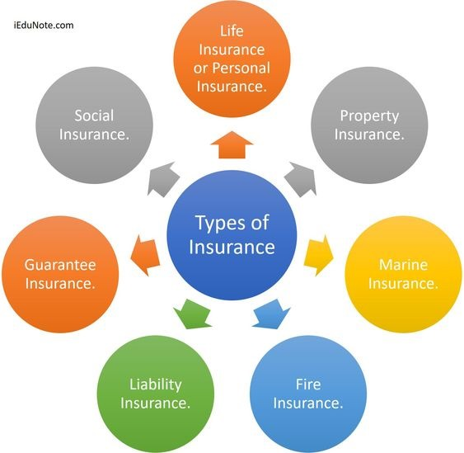
Data preprocessing
7

Slide 8
Data:
Dataset: Our dataset contains 7 variables and 1338 records​
Source: https://drive.google.com/drive/folders/1vGSRCnhqSxEH53BgLqhh32F1qNKqfOim?usp=drive_link
Variables:
Categorical variables | Continuous variables
Sex | Age
Smoker | BMI
Region | Children
 | Charges
8

Slide 9
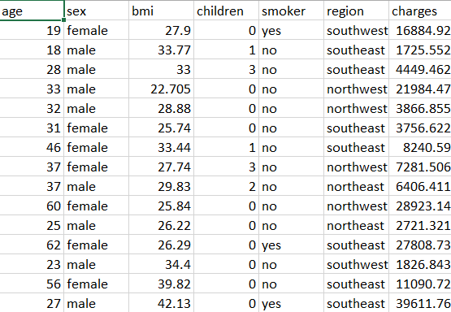
9

Slide 10
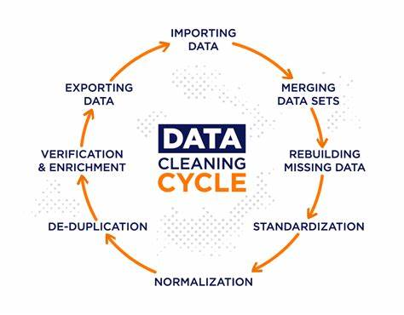
Data cleaning:
Duplicate values: We found a duplicate row, so we removed it. ​
Checked for missing values and unique values​
Since the dependent values were categorical, we converted them into numerical format.
We converted Boolean type values into integers.
10

Slide 11


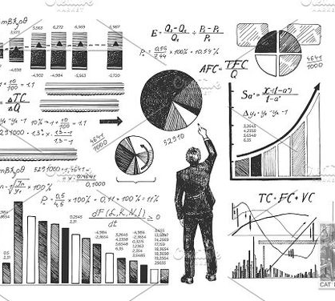
Exploratory data analysis
11

Slide 12
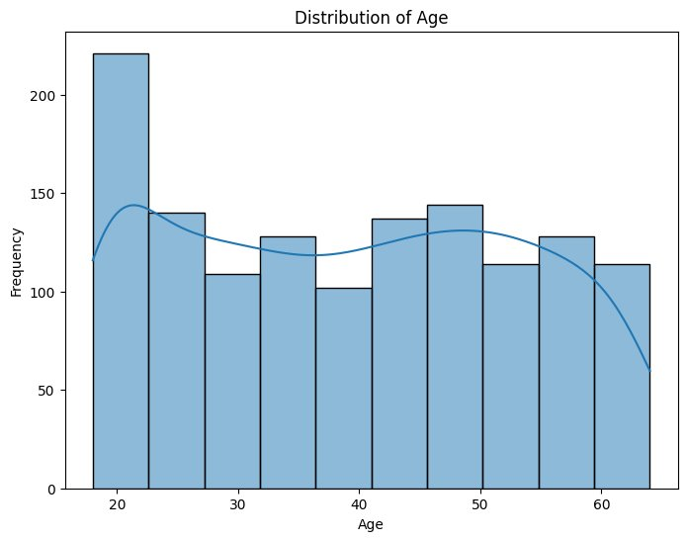
Histogram
This histogram shows the distribution of age, where most individuals fall in the 20–30 age group, indicated by the highest frequency. The frequency decreases slightly for older age groups, with some variation across intervals. A smooth line is overlaid to visualize the trend.
12

Slide 13
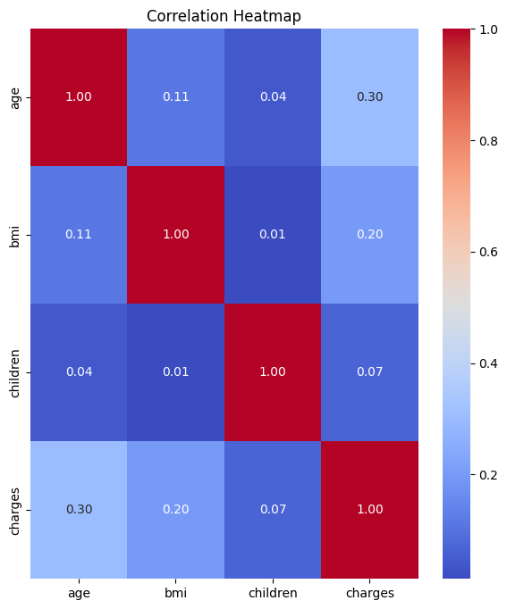
Correlation Matrix
This heatmap shows the correlation between variables. 'Charges' has a moderate positive correlation with 'age' (0.30) and a weaker correlation with 'BMI' (0.20), while other correlations are minimal. The diagonal values indicate a perfect correlation of each variable with itself.
13

Slide 14
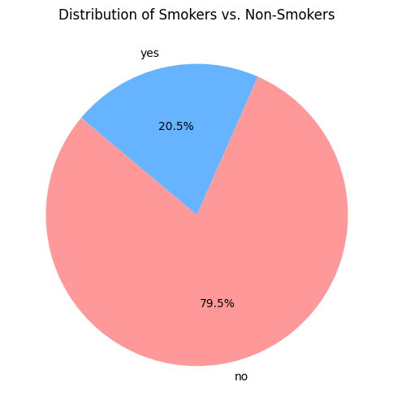
Pie chart
This pie chart shows the distribution of smokers versus non-smokers. A majority, 79.5%, are non-smokers, while only 20.5% are smokers.
14

Slide 15
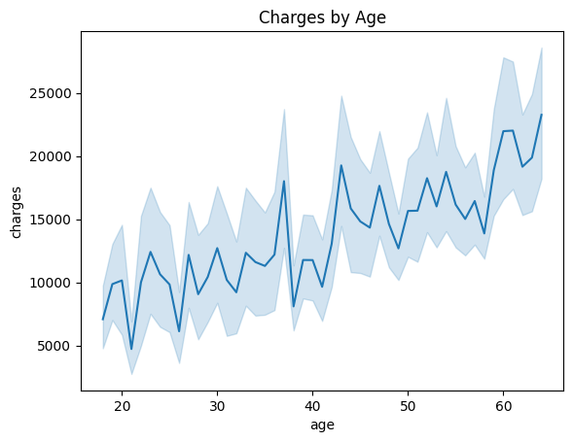
Line chart
This line chart shows the relationship between charges and age. It indicates an increasing trend in charges as age increases, with some fluctuations. The shaded area represents the confidence interval around the line, showing variability in the data.
15

Slide 16
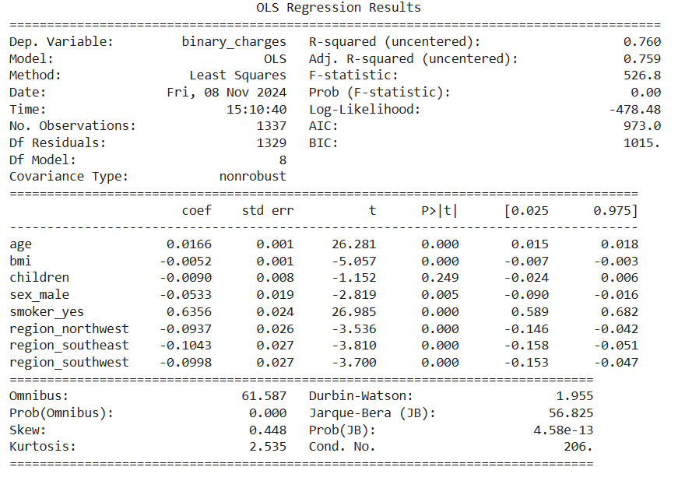
Significance test
Fitting ordinary least squares model with all the features: Leading Current Reactive Power(LeRP) has Greatest P-value which is insignificant
16

Slide 17
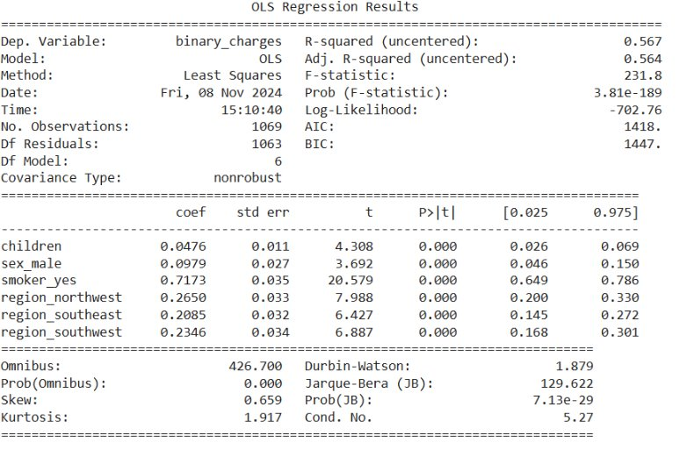
Significance test
Removing Insignificant variables: After removing variable having greatest P-value (greater than 0.05)
17

Slide 18
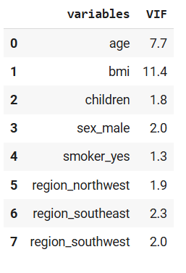
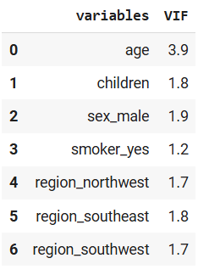
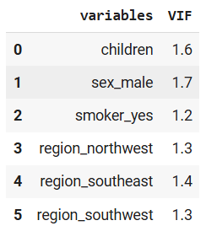
Multicollinearity check
Variables with the greatest variance inflation factor (VIF >3) were removed​
18

Slide 19
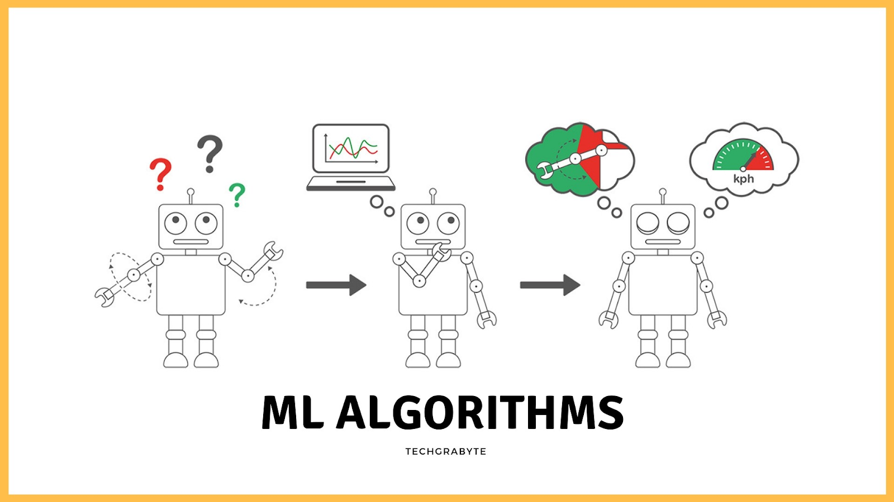

Machine learning
algorithms
19

Slide 20







Machine Learning algorithms
Multiple Linear Regression
K-Nearest Neighbors
Decision Tree
Random Forest
Bagging
Boosting
Support Vector Machine
20

Slide 21
80:20 Train-test split ratio
Algorithms | Model 1 | Model 2
Logistic Regression | 0.914 | 0.675
KNN | 0.865 | 0.634
Decision Tree | 0.929 | 0.682
Random Forest | 0.918 | 0.675
XG Boost | 0.936 | 0.686
Ada Boost | 0.891 | 0.682
SVM | 0.921 | 0.682
ANN | 0.932 | 0.716
Model 1: With all features | Model 2: After removing multi-collinear variables
21

Slide 22
75:25 Train-test split ratio
Algorithms | Model 1 | Model 2
Logistic Regression | 0.916 | 0.677
KNN | 0.850 | 0.629
Decision Tree | 0.919 | 0.680
Random Forest | 0.934 | 0.669
XG Boost | 0.919 | 0.677
Ada Boost | 0.910 | 0.686
SVM | 0.925 | 0.680
ANN | 0.933 | 0.723
Model 1: With all features | Model 2: After removing multi-collinear variables
22

Slide 23
70:30 Train-test split ratio
Algorithms | Model 1 | Model 2
Logistic Regression | 0.917 | 0.689
KNN | 0.825 | 0.636
Decision Tree | 0.925 | 0.694
Random Forest | 0.943 | 0.692
XG Boost | 0.932 | 0.706
Ada Boost | 0.895 | 0.703
SVM | 0.927 | 0.694
ANN | 0.931 | 0.715
Model 1: With all features | Model 2: After removing multi-collinear variables
23

Slide 24
60:40 Train-test split ratio
Algorithms | Model 1 | Model 2
Logistic Regression | 0.908 | 0.693
KNN | 0.814 | 0.639
Decision Tree | 0.914 | 0.700
Random Forest | 0.929 | 0.699
XG Boost | 0.923 | 0.691
Ada Boost | 0.917 | 0.700
SVM | 0.917 | 0.697
ANN | 0.938 | 0.722
Model 1: With all features | Model 2: After removing multi-collinear variables
24

Slide 25
Algorithms comparison (70:30)
Algorithms | Model 1 | Model 2
Logistic Regression | 0.917 | 0.689
KNN | 0.825 | 0.636
Decision Tree | 0.925 | 0.694
Random Forest | 0.943 | 0.692
XG Boost | 0.932 | 0.706
Ada Boost | 0.895 | 0.703
SVM | 0.927 | 0.694
ANN | 0.931 | 0.715
25

Slide 26
Summary
For Model 1, the Random Forest algorithm provided the best results, demonstrating high accuracy and reliable predictions for structured data. It effectively handled the dataset's complexity and produced robust outcomes. In contrast, for Model 2, the Artificial Neural Network (ANN) outperformed other algorithms, showcasing its ability to capture intricate patterns and relationships in the data. This highlights the suitability of Random Forest for structured datasets and the strength of ANN in handling more complex, non-linear problems.
These results highlight the importance of selecting the appropriate algorithm based on the characteristics of the dataset. Random Forest demonstrated superior performance in handling structured data, while ANN excelled in scenarios requiring advanced pattern recognition and non-linear analysis.
26

Slide 27
Future Scope
Hybrid Models: Combining Random Forest and ANN can leverage their strengths for improved predictions.
Optimization: Advanced hyperparameter tuning methods like Grid Search or Bayesian Optimization can enhance performance.
Feature Engineering: Using automated techniques can improve model accuracy and interpretability.
Diverse Applications: The approach can be applied to complex datasets in healthcare, finance, and more.
Deep Learning Exploration: Exploring architectures like CNNs or RNNs can uncover new possibilities.
Real-World Deployment: Scaling and deploying models efficiently for practical use.
27

Slide 28
Work Distribution
Team | Contribution
Lokesh Kumar | Collect Information & Literature review
K.Manohar | Data Preprocessing
A.Deepak Mudiraj | Exploratory Data Analysis
N.Keerthana Reddy | Implement Machine Learning Algorithms
28

Slide 29
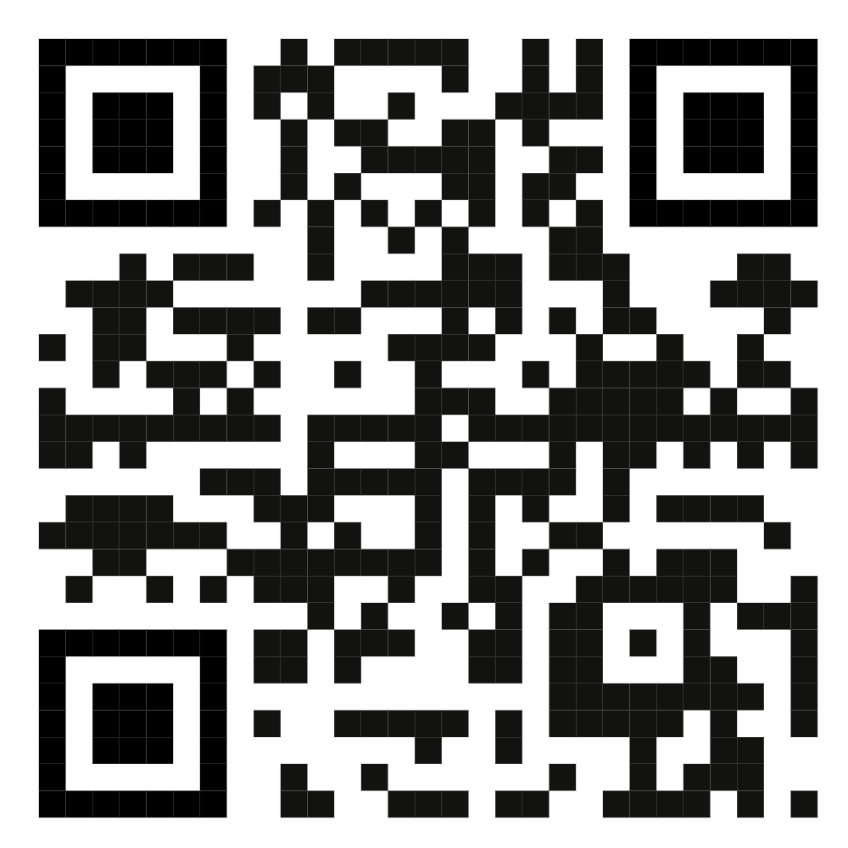
Thank you
Group 5
N.Keerthana Reddy
A.Deepak Mudiraj
Lokesh Kumar
K.Manohar
29

Slide 30
Appendix
30

Slide 31
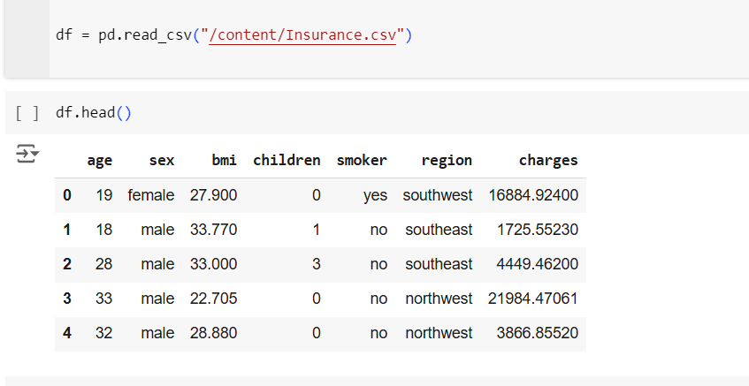
Loading the Dataset
31

Slide 32
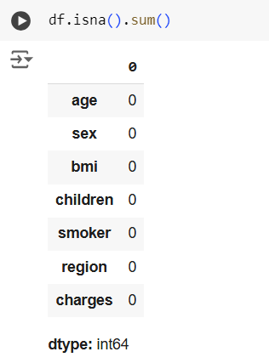
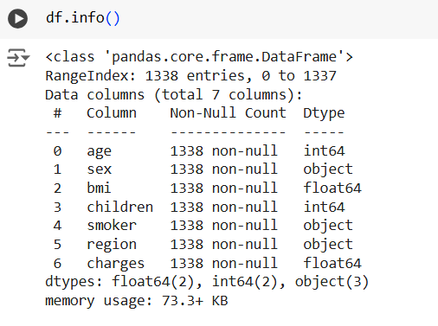
Null Values
Checking for the data type
32

Slide 33
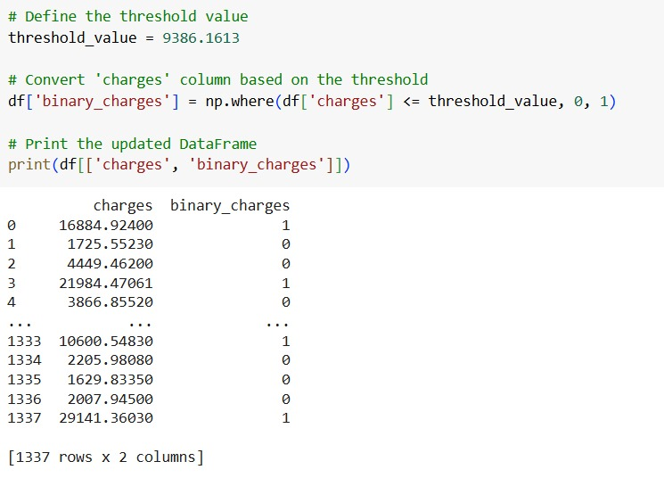
Dependent Variable
33

Slide 34
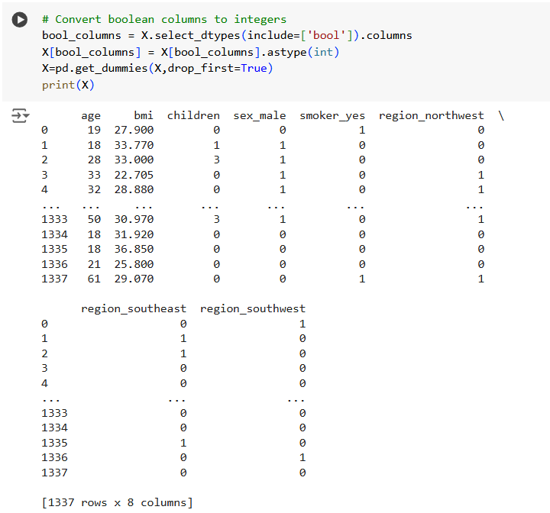
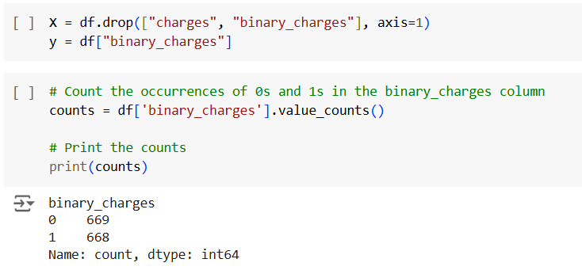
Dropping the columns
34

Slide 35
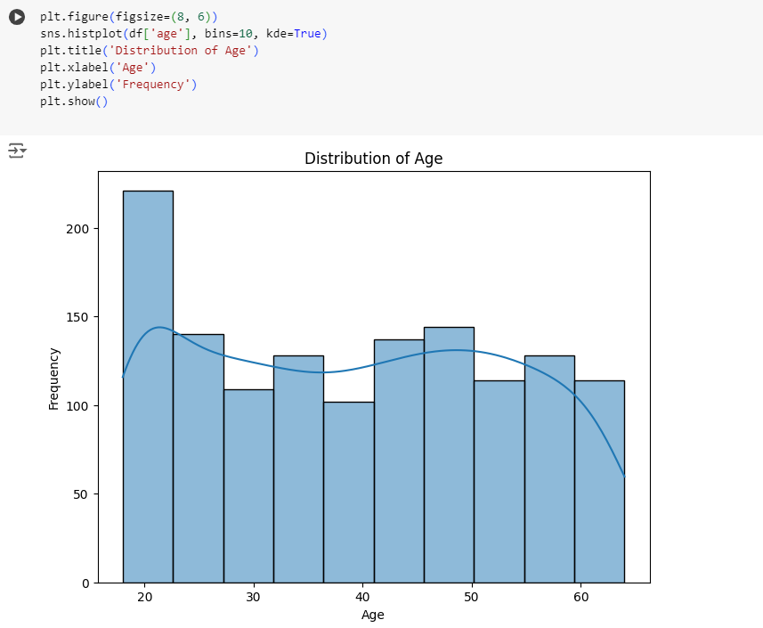
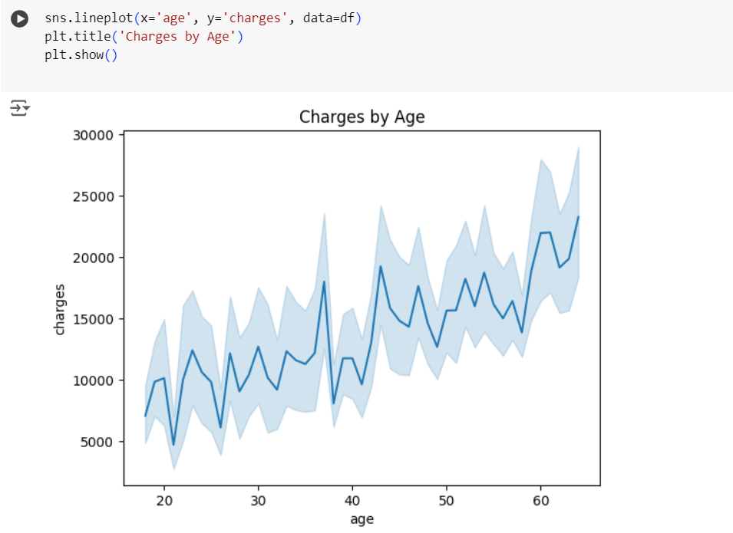
Data visualization
35

Slide 36
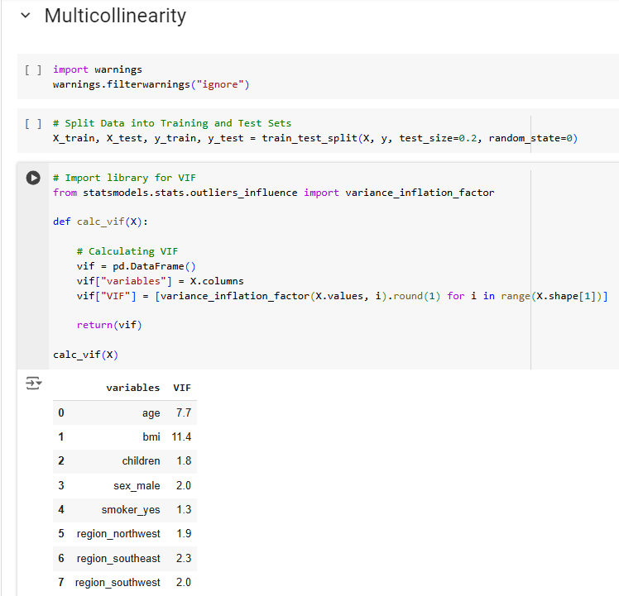
Multi collinearity check
36

Slide 37
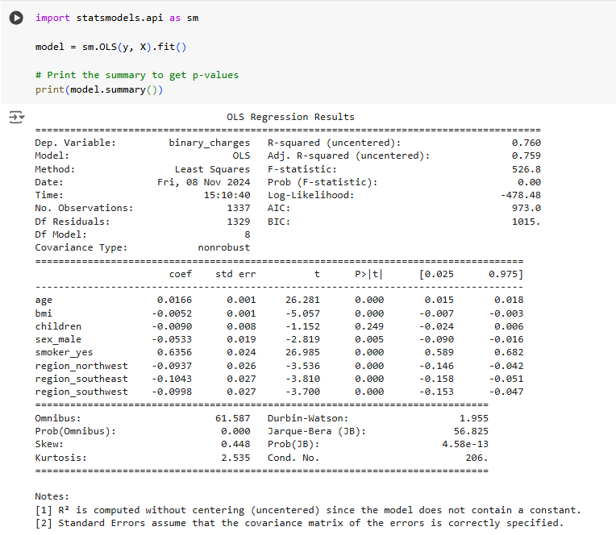
Ordinary least squares
37

Slide 38
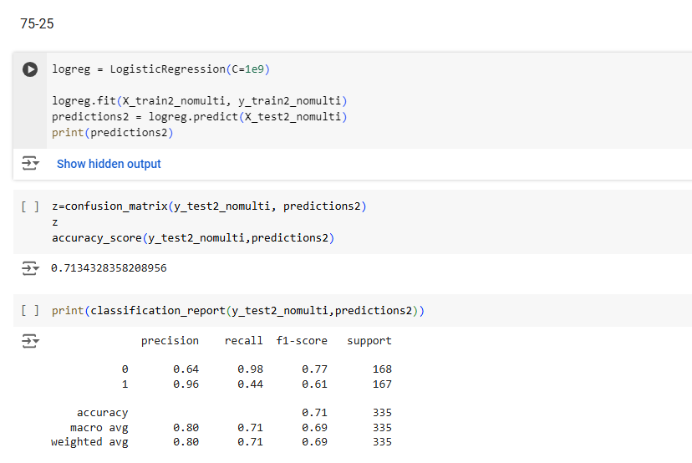
Logistic Regression
38

Slide 39

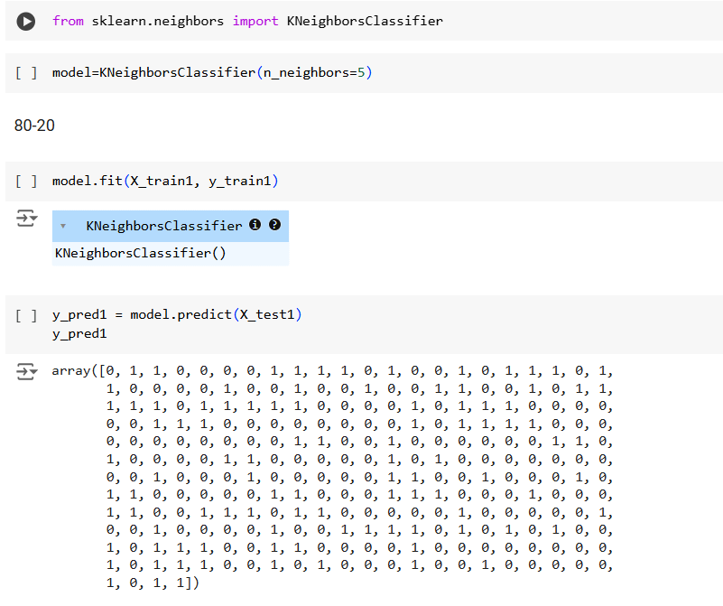
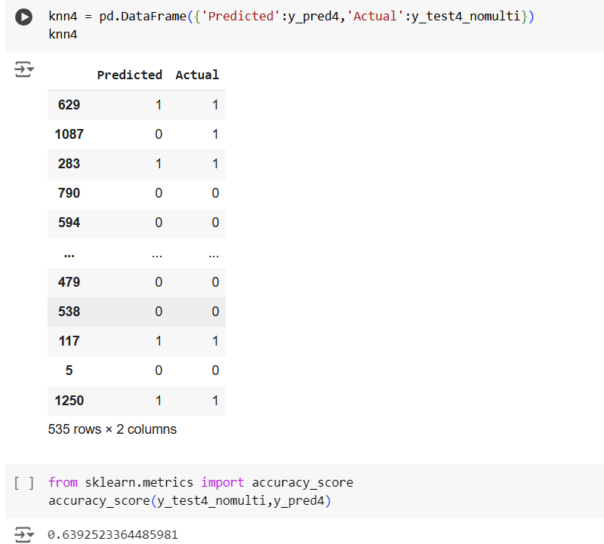
K-Nearest Neighbors
39

Slide 40
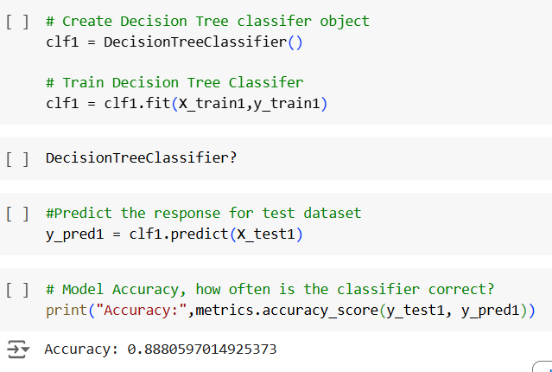
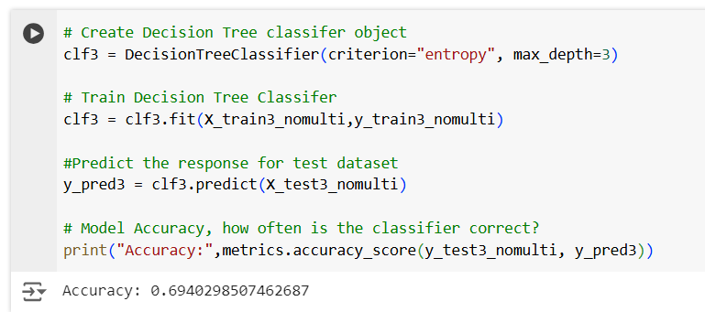
Decision tree
40

Slide 41
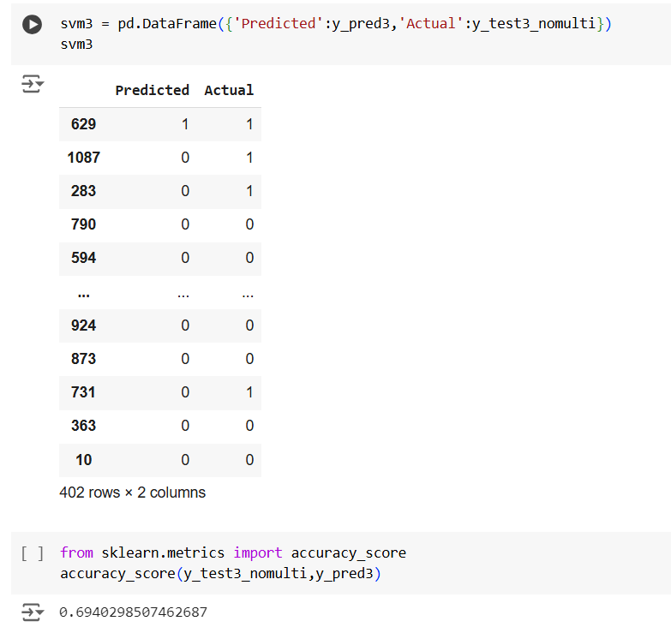
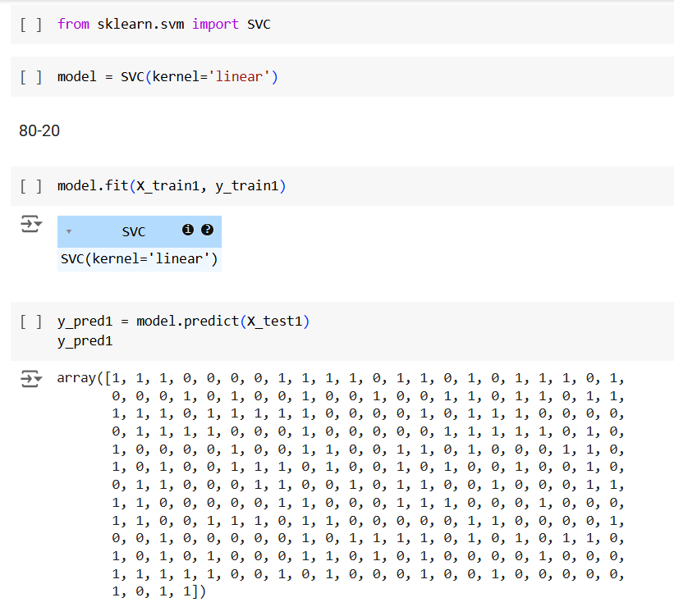
Support vector Machine
41

Slide 42
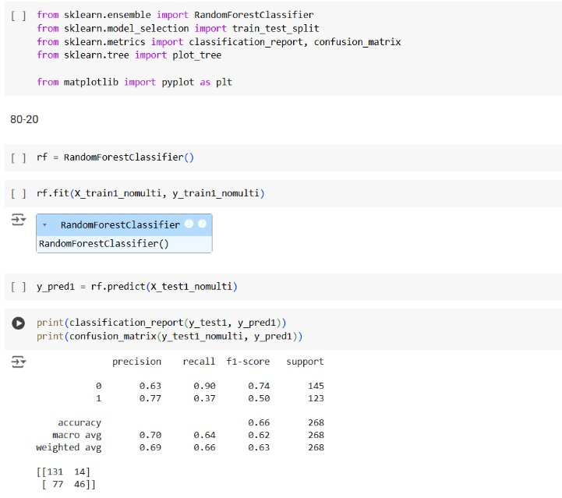
Random Forest
42

Slide 43
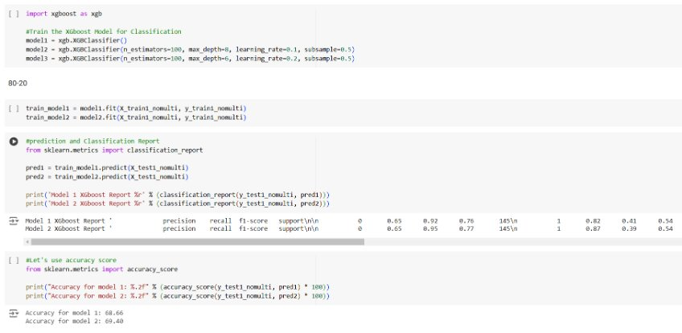
XGBoost
43

Slide 44
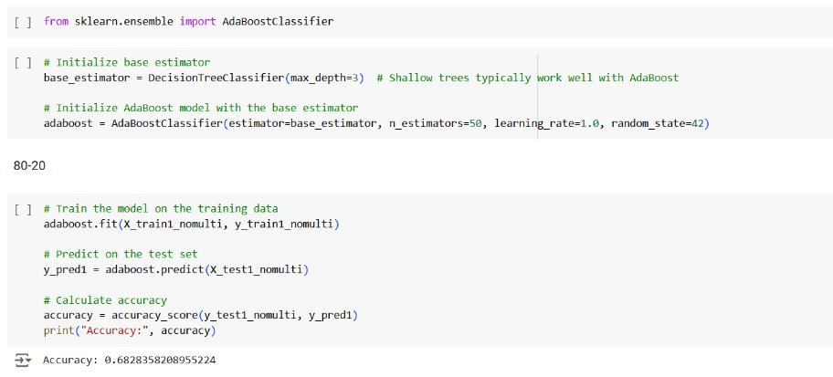
ADA Boost
44

